Slide 1


JAVA INTERVIEW BOOTCAMP
Lecture 8

Slide 2

Today’s Agenda
Data Types
Categories Of Data Types
Integer Literals
Decimal Literals
Character Literals
Boolean Literals

Slide 3
Primitive Data Types
Primitive data types, as the name suggests, are the language defined data types .
Java defines the following eight primitive data types:
char
byte
short
int
long
float
double
boolean

Slide 4
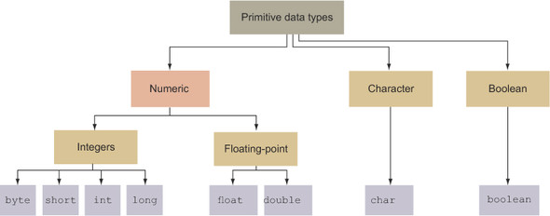
Categorization Of Primitive Data Types

Slide 5
Numeric Data Types
The numeric category defines two subcategories: integers and floating point (also called decimals).
Integers: byte, int, short, long
When we can count a value in whole numbers, the result is an integer.
It includes both negative and positive numbers.

Slide 6

Integers
Integer Types
Type | Size (In Bytes) | Range
byte | 1 | -128 to 127
short | 2 | -32768 to 32767
int | 4 | -2147483648 to 2147483647
long | 8 | -9223,372,036,854,775,808 to 9223,372,036,854,775,807

Slide 7
Flavors Of Integer Literals
Integer literal values come in four flavors: binary, decimal, octal, and hexadecimal.
Binary number system— A base-2 system, which uses only 2 digits, 0 and 1.
Octal number system— A base-8 system, which uses digits 0 through 7 (a total of 8 digits). Here the decimal number 8 is represented as octal 10, decimal 9 as 11, and so on.

Slide 8
Flavors Of Integer Literals
Decimal number system— The base-10 number system that we use every day. It’s based on 10 digits, from 0 through 9 (a total of 10 digits).
Hexadecimal number system— A base-16 system, which uses digits 0 through 9 and the letters A through F (a total of 16 digits and letters). Here the number 10 is represented as A, 11 as B, 12 as C, 13 as D, 14 as E, and 15 as F.

Slide 9
Flavors Of Integer Literals
For octal literals, use the prefix 0; for binary, use the prefix 0B or 0b and for hexadecimal, use the prefix 0x or 0X.
Given below are 4 ways of representing the integer value 12
int i=12;
int j=0b1100;
int k=014;
int l=0xC;
System.out.println(i);
System.out.println(j);
System.out.println(k);
System.out.println(l);
OUTPUT:
12
12
12
12

Slide 10

Flavors Of Integer Literals
With Java version 7 we also can use underscores as part of literal values to make them more readable.
Here’s an example:

Slide 11
Rules For Underscore
You can’t start or end a literal value with an underscore.
You can’t place an underscore right after the prefixes 0b, 0B, 0x, and 0X, which are used to define binary and hexadecimal literal values.
You can place an underscore right after the prefix 0, which is used to define an octal literal value.
You can’t place an underscore prior to an L suffix
Remember- the L suffix is used to mark a literal value as long.

Slide 12
Test Your Skills
long a=0_100_267_760;
Correct! Octals can have underscore after prefix 0
long b=0_x_4_13;
Error! Underscore not allowed before or after or in mid of hex
prefix 0x
long c=0x1_0000_10;
Correct! Hex can have underscore at a place other than with
prefix
long d=100_12_12;
Correct! Underscore can be in between a value

Slide 13
Flavors Of Decimal Literals
In Java, we can use the float and double primitive data types to store decimal numbers.
float requires less space than double, but it can store a smaller range of values than double.
A float data type also has less precision.

Slide 14
Decimals
Decimals Numbers
Type | Size (In Bytes) | Range
float | 4 | -3.4 * 10³⁸ to 3.4 * 10³⁸ (6 significant decimal digits)
double | 8 | -1.7*10³⁰⁸ to 1.7*10³⁰⁸ (15 significant decimal digits)

Slide 15
Flavors Of Decimal Literals
Suffixes ‘f’ and ‘F’ are used to denote float values and ‘d’ and ‘D’ for double .
Although for double suffix is optional
Here’s an example of each of these:
float average = 20.129F;
float orbit = 1765.65f;
double inclination = 120.1762;
double inclination=120.1762D;

Slide 16

Rules For Underscore
You can’t place an underscore prior/after a D, d, F, or f suffix.
You can’t place an underscore adjacent to a decimal point.

Slide 17
Character Literals
A char can store a single 16-bit Unicode character
It can store characters from almost all the existing scripts and languages.
Type | Size | Range
char | 2 | 0 to 65535

Slide 18
Popular Interview Question
Why Java uses 2 bytes for characters ?
In Java almost 61 international languages are supported , including Japanese, Korean, Chinese, Devanagari, French, German, Spanish, and others.
Now, the characters and symbols of these languages cannot be accommodated in 1 byte space in memory ,so Java takes 2 byte for characters.
Java supports UNICODE but C language supports ASCII code. In ASCII code we can represent characters of English language, so for storing all English latter and symbols 1 byte is sufficient.

Slide 19
Character Literals
But UNICODE character set is superset of ASCII in which all the characters which are available in 61 international languages are supported and it contains 65536 characters ranging from 0 to 65535
To assign UNICODE values we have two options:
Use the numeric value
OR
Use the format ‘\uxxxx’ where xxxx is hexadecimal form of the value
For example:
char ch=65;
OR
char ch=‘\u0041’;
Both means we are assigning letter A

Slide 20
Character Literals
Here’s an example to display hindi alphabet 'अ’:
char ch=‘\u0905’;
System.out.println(“ch=“+ch);
For a complete list of hindi characters unicode values visit:
https://www.anirdesh.com/gujarati/hindi-unicode.php

Slide 21
Display Hindi Numbers From ० To ९
class PrintHindi {
public static void main(String [] args)
{
char v='\u0966';
for(int i=1;i<=10;i++){
System.out.println(v++);
}
}
}
OUTPUT:
०
१
२
३
४
५
६
७
८
९

Slide 22
Boolean Literals
The Boolean category has only one data type: boolean.
A boolean variable can store one of two values: true or false.
It is used in scenarios where only two states can exist.

Slide 23
Boolean Literals
Boolean
Type | Size | Range
boolean | JVM Dependent | true or false

Slide 24
Guess The Output ?
public class MyChar
{
public static void main(String[] args)
{
int myInt = 7;
bool result = true;
if (result == true)
do
System.out.println(myInt);
while (myInt > 10);
}
}
Options
1. It prints 7 once.
2. It prints nothing.
3. Compilation error.
4. Runtime error.
Answer :
3

Slide 25
Type Conversion
What is type conversion ?
Whenever the compiler encounters a statement where the value on right side of assignment is different than the variable on left , then the compiler tries to convert R.H.S to L.H.S and this automatic conversion done by compiler is called as Type Conversion.

Slide 26
Type Conversion
For example:
Consider the following statement:
x = y;
In this case two things might happen:-
1 . If data type of both variables are same then value of y
will be assigned to the variable x.
2. But if data type of both variables are different then the value of y needs to be converted as per the data type of variable x and this is called “Type Conversion”

Slide 27
Type Conversion
Forms Of Type Conversion
In Java ,type conversion is of two types
Implicit Conversion
( automatically done by compiler)
Explicit Conversion
( specially done by programmer , also called Type Casting)

Slide 28
Rules For Implicit Conversion
For implicit conversion there are 2 conditions which must be true :
The values must be compatible/convertible.
AND
The value on RHS of assignment must be smaller than variable on LHS
If both these rules are followed then Java will implicitly
convert the value otherwise conversion has to be done by the
programmer
Let us understand them in depth

Slide 29

Rule 1 : Convertible
Convertible means it must be possible for Java to convert a value from one form to another.
For example , it is possible for Java to convert a character to an integer using it’s UNICODE/ASCII value .
So the following will compile:
int x=‘A’;
But it is not possible for java to convert the boolean value “true” to integer as the values “true” and “false” have no other representation.
So the following statement will not compile:
int x=true;

Slide 30
Rule 2 : Smaller
Smaller means the range of a variable’s data type must be a smaller than other variable’s range. NOT THE SIZE
For example , a short data type variable has a range of -32768 to 32767 which is smaller( proper subset) of the range of an int variable whose range is -2147483648 to 2147483647, so “short” is considered to be smaller than an “int”.
Another example, an int is of 4 bytes and has a range of
-2147483648 to 2147483647 while a float is also of 4 bytes but has a range of -3.4*10³⁸ to 3.4 *10³⁸ which is greater than the range of int , so int is smaller than float.

Slide 31
QUIZ
Is a long data type smaller than float ?
Yes
No
Because the range of long is smaller than range of a float.

Slide 32




Examples
1. byte a=10;
int b;
b=a;
because [range of int > byte]
2. int a=10;
byte b;
b=a;
because [range of byte<int] ------------lossy conversion
b=(byte)a; you have to do explicit conversion
3. int a=128;
byte b;
b=a;
because ---[ range of int>byte]
b= (byte)a; [b will become -128 as here after type conversion, rotation will take place]

Slide 33


Examples
4. short a=10;
int b;
b=a;
because range of [short<int]
5. int a =10;
short b;
b=a;
because range of [int>short]
b=(short)a;
(you have to do explicit conversion)
6. int a=32768;
short b;
b=a;
b=(short)a;
But yet value is also out of range java does rotation and assign the value -32768 to the variable b

Slide 34



Examples
7. int a=10;
long b;
b=a;
because range wise [long >int] so, its correct.
8. long a=10;
int b;
b=a;
because long value can’t assign to int , it’s an error
b=(int)a;
you have to do explicit conversion.
9. long a=2147483648;
int b;
b=a;
because if any integer constant crosses the range of int data type then it has no meaning for java compiler.
long a=2147483648L;
int b;
b=a;
because long is assigned to integer so,error: lossy conversion.
b=(int)a;
value is out of range so, compiler rotates it’s values(-2147483648)
error: Integer number too large

Slide 35
Examples
10. byte a=10;
char b;
b=a;
because range wise char is not > than byte as char starts from 0 and byte starts from -128.
11. char a=‘x’;
byte b;
b=a;
because range wise byte is not > than char as byte ends at 127 while char ends at 65535
12. short a=10;
char b;
b=a;
because range wise char is not > than short as char starts from 0 and short starts from -32768.
13. char b=‘x’;
short a;
a=b;
because range wise short is not > than char as short ends at 32767 while char ends at 65535.
14. int a=10;
char b;
b=a;
because range wise char is smaller than int.
15. char b=‘x’;
int a;
a=b;
because range wise int is > than char

Slide 36

Examples
16. double a=1.7;
float b;
b=a;
because [double>float] possible loss of precision.
b=(float)a;
17. float a=1.7;
because every decimal constant by default is a double and
double is > than float .
Solution is to suffix it with f or F
18. float a=1.7f;
double b;
b=a;

Slide 37
Examples
19. boolean a=true;
int b;
b=a;
20. boolean a=true;
int b;
b=a;
21. int a=1;
boolean b;
b=(boolean)a;
22. int a=1;
boolean b;
b=(boolean)a;
Error Message :- Incompatible Types
because boolean cannot be converted into any type implicitly or explicitly.

Slide 38
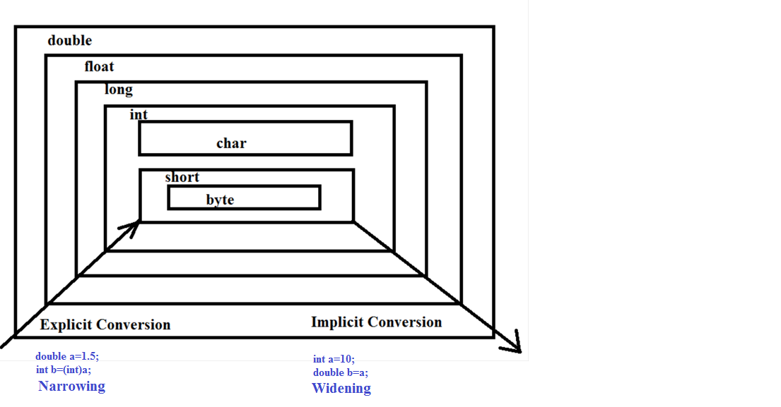
Conversion Diagram

Slide 39
Type Conversion In Expression
Previous type conversion is called type conversion in assignment.
Java follows another type conversion called type conversion in expression.
Java follows this rule in arithmetic expressions and converts a lower type value to higher type as per the operands involved
byte
short
char int
int long long
float float
double double

Slide 40


Type Conversion In Expression
byte a=10,b=20;
byte c
c = a + b;
possible loss of precision. [byte < int]
because both a and b are bytes java converts them to int
Sol:-1
c=(byte)(a+b);
not reliable as byte is < int so there maybe rotation of value.
Sol:-2
byte a=10,b=20;
int c;
c=a+b; more reliable

Slide 41
QUIZ
Which of these is necessary condition for automatic type conversion in Java?
A. The destination type is smaller than source type.
B. The destination type is larger than source type.
C. The destination type can be larger or smaller than source
type.
D. None of the mentioned.
Answer
B

Slide 42
QUIZ
What is the error in this code? byte b = 50; b = b * 50;
A. b can not contain value 2500, limited by its range.
B. * operator has converted b * 50 into int, which can not be converted to byte without casting.
C. b can not contain value 50.
D. No error in this code.
Answer
B

Slide 43
QUIZ
If an expression contains double, int, float, long, then whole expression will promoted into which of these data types ?
A. long
B. int
C. double
D. float
Answer
C

